Slide 1
Performance Analysis
DevTools Basics

Slide 2
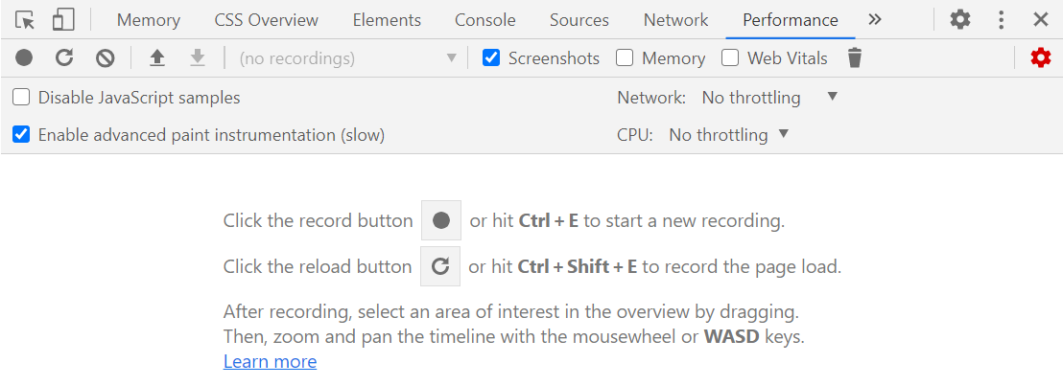
Open DevTools Performance Tab
Open DevTools
Ctrl
Shift
i

Slide 3
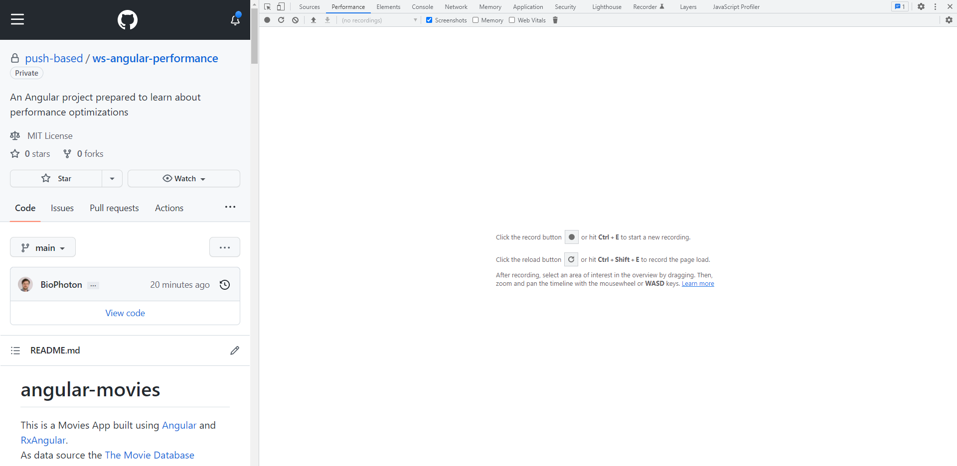
Start Recording
Ctrl
E
Record refresh
Ctrl
Shift
E

Slide 4
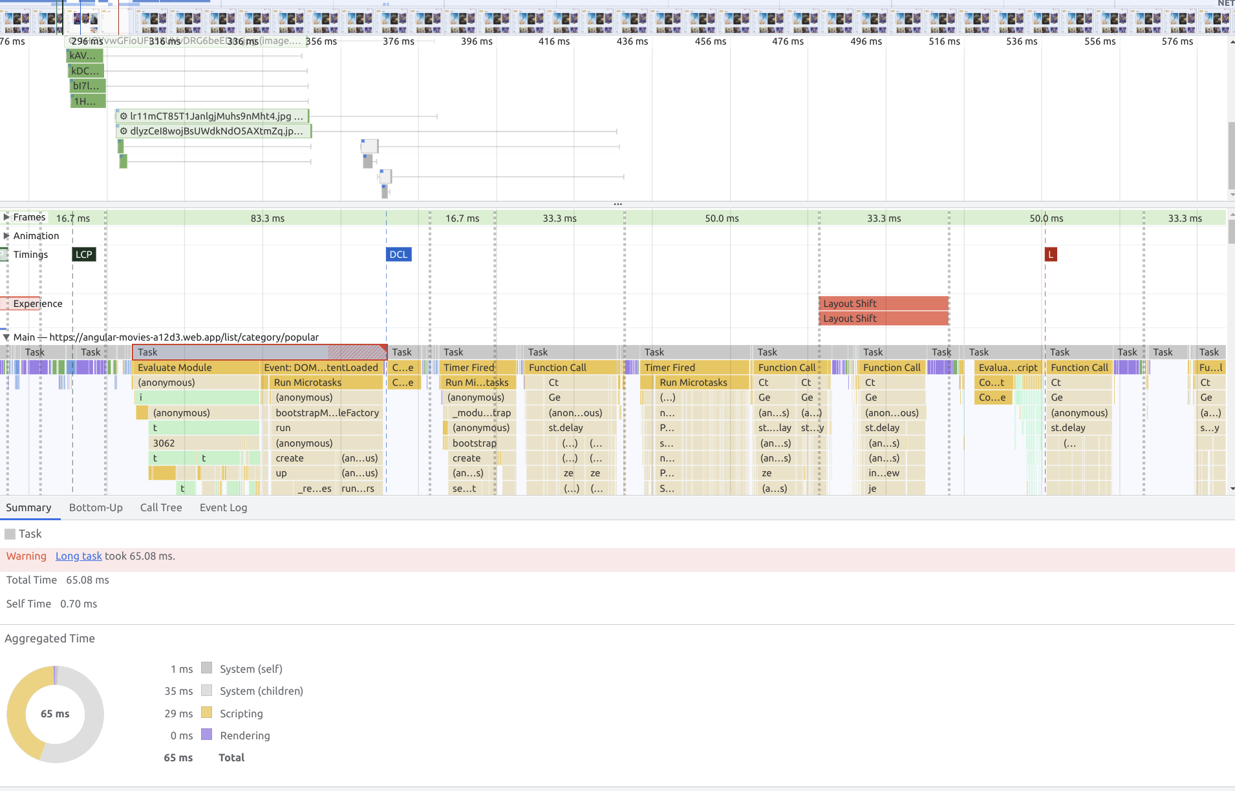
Filmstrip
Network
FPS, Experience, Timings
Main thread
Script Flame Chart
Summary

Slide 5
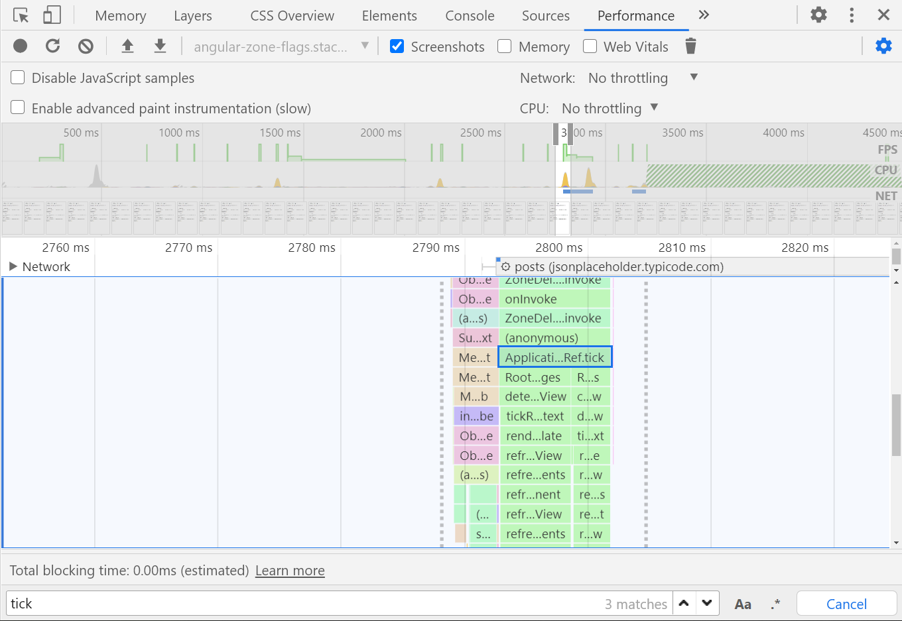
Search in performance profile
Ctrl
f
Enter

Slide 6
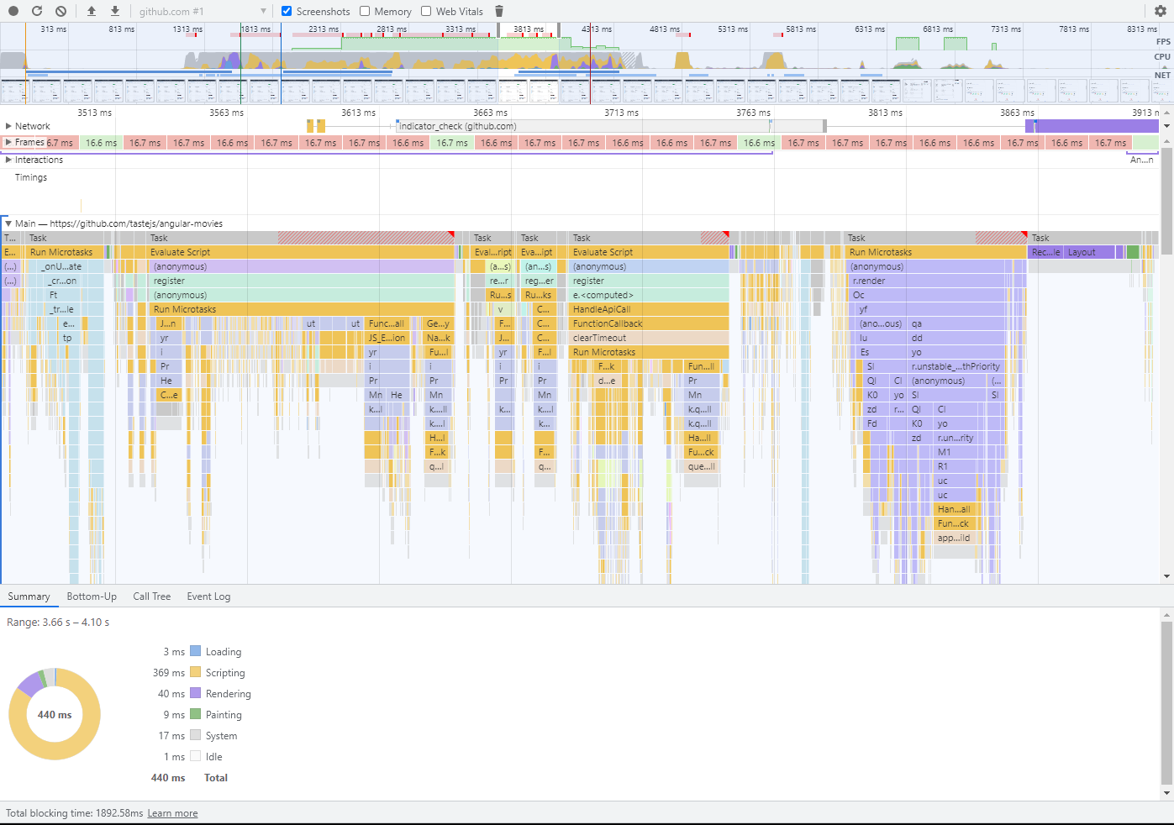
Frame Drop
[ 1 ] Long task
Tasks that harm UX >50ms
[ 2 ] Frame Rate Low areas show good FPS, high a bad FPS rate
[ 3 ] Total Blocking Time Sum of blocking times of all tasks in the measure.
1
1
1

Slide 7
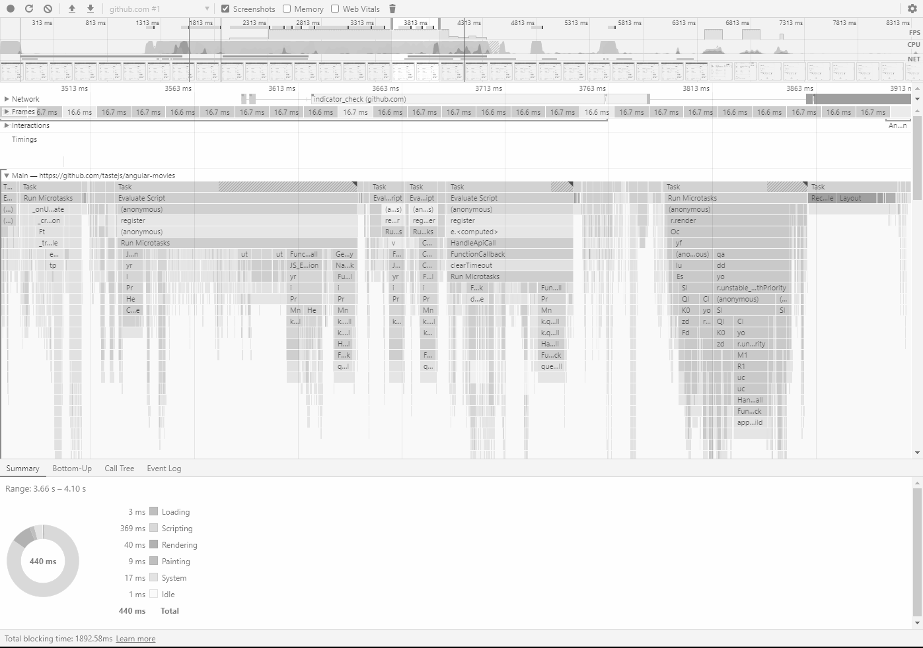
Frame Drop
[ 1 ] Long task
Tasks that harm UX >50ms
[ 2 ] Frame Rate Low areas show good FPS, high a bad FPS rate
[ 3 ] Total Blocking Time Sum of blocking times of all tasks in the measure.
1
2
3

Slide 8
Frame Drop
[ 1 ] Long task
Tasks that harm UX >50ms
[ 2 ] Frame Rate Low areas show good FPS, high a bad FPS rate
[ 3 ] Total Blocking Time Sum of blocking times of all tasks in the measure.
1
1
1
1
2
3

Slide 9

Task Detail View
Task
Type
Event: click
work
work2
…
…
…
…
Scripting
Layout, Styles
Paint, Composite

Slide 10
Task Detail View
any.component.ts
work();
work2();
Task
Event: click
work
work2
…
…
…
…

Slide 11
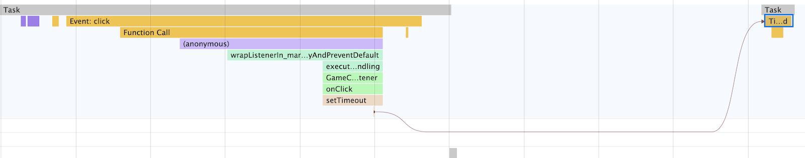
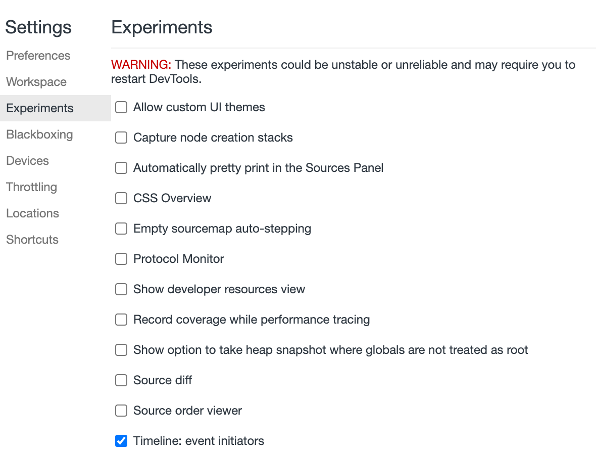
Enable Timeline Event Initiators

Slide 12

Demo & Exercise Time!
Performance Tab & Flame Chart analysis

